Slide 1
SNOMED
Curtesy: Health & Social Care Information Center, UK

Slide 2
Key Messages
We are seeing the biggest change in healthcare that we’ve seen in years
Care model is going to change
Electronic records are driving improvements in care
Shared care
Wherever the patient goes, the person treating them should have access to key information about this patient
Analysis of patient data throughout healthcare will be used to improve patient care
IT needed to support the growing knowledge that helps personalised patient care
Notes:
We are seeing the biggest change in healthcare that we’ve seen in years.
The care model is going to change and electronic records are driving improvements in care.
There will be shared care with trusts, GP’s, patients, community etc. so that wherever the patient goes, the person treating them should have access to key information

Slide 3
Strategy
Aim: Patient centred – patients can view own records
Actions:
Interoperability – move data around electronically
Record once, use many times
All require a common standardised vocabulary
Notes:
Moving onto the strategy behind this.
The aim is for everything to be patient centred so that patients are able to view their own records.
In order for this to be possible it is necessary for information to be easily accessible. Moving data around electronically will make it easier to share information.
And for all this to be possible we require a common standardised vocabulary.

Slide 4
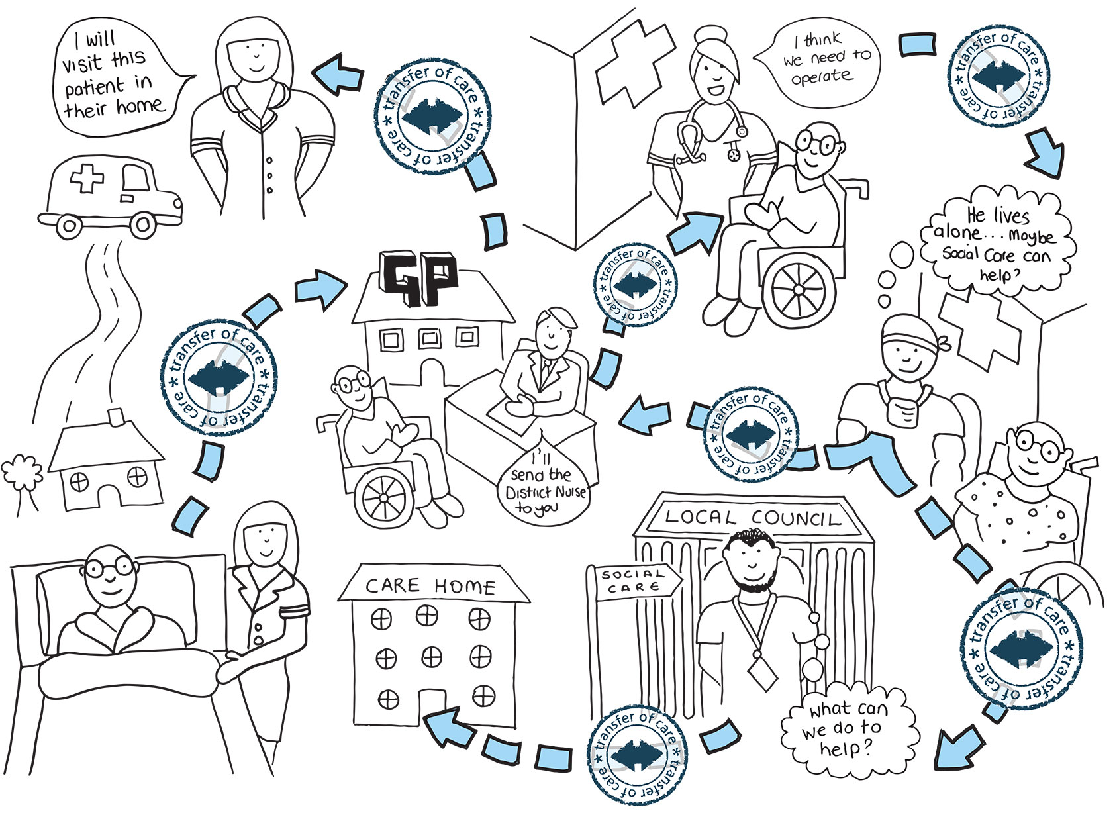
Transfer of Care Initiative
Notes:
This diagram illustrates some scenarios where information about a patient is exchanged.
The Transfer of Care Initiative is a project that aims to improve patient care by driving the establishment and uptake of professional and technical document standards.
Using standards in electronic health care records allows clinical information to be recorded, exchanged and accessed consistently across care settings in order to deliver high quality care to patients.
SNOMED CT is the clinical terminology standard that will be used.

Slide 5
Data Representation: Machine and Human
Effective communication for human and machine is essential for quality care
What can we develop to capture the semantics of data in medical practices and also can be shared easily with different physicians.
What data representation can we develop that can facilitate the communication among physicians, patients, and machines.

Slide 6

SNOMED Clinical Terms (CT)
Systematized Nomenclature Of Medicine – Clinical Terms
It is a standardized, multilingual vocabulary of clinical terminology that is used by physicians and other health care providers for the electronic exchange of clinical health information.
It is the collection of medical terms providing codes, terms, synonyms and definitions used in clinical documentation and reporting.
It is the most comprehensive, multilingual clinical healthcare terminology in the world.
The primary goal is to encode the meanings in healthcare and support the effective clinical recording of data to improve patient care.
It provides the core general terminology for EMR

Slide 7
SNOMED CT
It can be mapped to other coding systems, such as ICD-9 and ICD-10
IT benefits individual patients and clinicians, as well as populations, and it supports evidence based care.
In EMR, SNOMED CT can represent relevant clinical information consistently and comprehensively as an essential part of producing EMR systems
In USA, regulations have designated that SNOMED CT be the national standard for additional categories of information in EHRs and for additional health information exchange transactions.

Slide 8
Benefits
There are many benefits of using SNOMED CT in Electronic Health Records including:
Health information can be shared consistently within and across healthcare settings.
Data can be organized, queried, and analyzed for the benefit of the individual and institution.
The risk of different interpretations of the record between different healthcare settings can be reduced.
Can remove language barriers as it enables multilingual use.
Updated twice a year to help users keep pace with the advances of healthcare terminology and add to the scope of coverage

Slide 9
Why SNOMED CT?
SNOMED CT has been selected and approved as the terminology to be adopted by the majority of countries. It is the most comprehensive international terminology currently available and can be used across all care settings and all clinical domains.
Terminologies are designed to be used by clinicians in their recording of data in a patient record. Classifications are intended for population statistics and analysis.
Notes:
In healthcare, the requirements for coding are extensive. SNOMED CT provides a comprehensive set of such clinical phrases or terms, this is called a terminology.
A standard clinical terminology is essential for the interoperability of electronic health records across care settings.
SNOMED CT has been selected and approved as the terminology to be adopted by the NHS in England. It is the most comprehensive international terminology currently available and can be used across all care settings and all clinical domains.

Slide 10
Interoperability
With an agreed structure data can be passed from one system to another
Patient visits GP
To achieve this we need to use structured records and a structured terminology
Discharge summary returned to GP
GP makes referral to Trust
SNOMED CT
Discharge Summary (may contain SNOMED CT)
Using Choose & Book to make the referral
Diagnosis of patient recorded using SNOMED CT
Reason for referral is recorded using SNOMED CT
Clinician treats Patient
Notes:
If the same structured terminology is used across the different care settings, then the information transferred between these care settings would not require converting and would, therefore, lose none of its meaning. This transfer of information between systems is known as interoperability.
In this example a patient visits their GP, makes an appointment to see a consultant via choose and book, is treated by the consultant and the relevant discharge summary returned back to the GP.
The applications save time, but the fact that the information can be directly transferred between systems is also beneficial. Using Choose and Book takes time out of the process so that targets such as the 18 week limit are hit easier. It also provides the patient with choice so they can, for example, select where to go based on things such as waiting times or on ease of travel. When the GP chooses the reason for the referral, the choices given are SNOMED CT terms.
If the clinical information is recorded using the same structured terminology then it can be transferred between the systems losing none of its meaning as there is no need to ‘convert’ it.

Slide 11
SNOMED CT
SNOMED CT
Outpatient
Community
Acute
Mental Health
Emergency
Laboratories
Use of Synonyms helps cater for different expressions with the same meaning
Notes:
As we have said SNOMED CT covers multiple care settings.
One way of catering for all the different care settings is that SNOMED CT supports the difference in language used by clinicians, e.g. one clinician might say heart attack, another cardiac infarction and another myocardial infarction, but they would all come under the same concept myocardial infarction 22298006 with the synonyms allowing for the different ways of saying the same thing. Synonyms allow for different expressions with the same meaning.
SNOMED CT is a dynamic product, constantly being updated and in the UK, at the moment, SNOMED CT is updated every six months.

Slide 12
SNOMED CT – What is it?
SNOMED CT is a clinical terminology
Systematized Nomenclature of Medicine (Clinical Terms)
Collection of names and words
Relevant to the field of medicine
Organised in a structured and logically consistent manner
Notes:
And these words that are relevant to the field of medicine are organised in a structured and logically consistent manner.

Slide 13
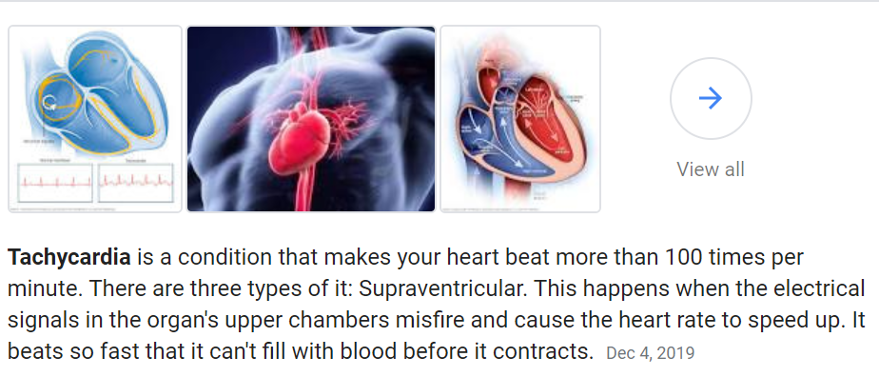
SNOMED CT Content
Clinical Findings
Disease and deformity – scar
Symptoms – difficulty breathing
Causes of Disease
Forces – pressure change
Events – road traffic accident
Procedures
Laboratory
Therapy
Examination findings – tachycardia
Organisms – Coronavirus
Surgical procedure
Social – finding of walking aid use
Clinical Investigation
Notes:
These two slides give a general overview of what sort of content is in SNOMED CT and how SNOMED CT is structured. There are 19 hierarchies in SNOMED CT and rather than go through each one individually this puts them in groups to give you a feel for the type of coverage of content. If you require more detailed information about the hierarchies it can be found on our website.
So on this slide we have
Clinical findings which includes areas such as diseases, symptoms and examination findings
Causes of disease includes areas such as forces, events and organisms
Procedures are pretty self explanatory but include items such as operations, investigations and therapies

Slide 14
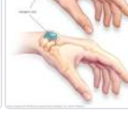
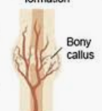
SNOMED CT Content
Anatomy
Normal – knee joint
Abnormal – ganglion cyst
Observations
Vital signs – blood pressure
Body product observable – colour of urine
Products
Drugs – paracetamol
Substances – latex
Devices – bedpan
Lesions – bony callus
Values - present
Notes:
On this slide we look at
Anatomy which includes both normal and abnormal anatomy
Observations include items such as vital signs and values
And finally products include devices and drugs, that is the drugs we are familiar with together with the individual ingredients that go to make up those drugs

Slide 15
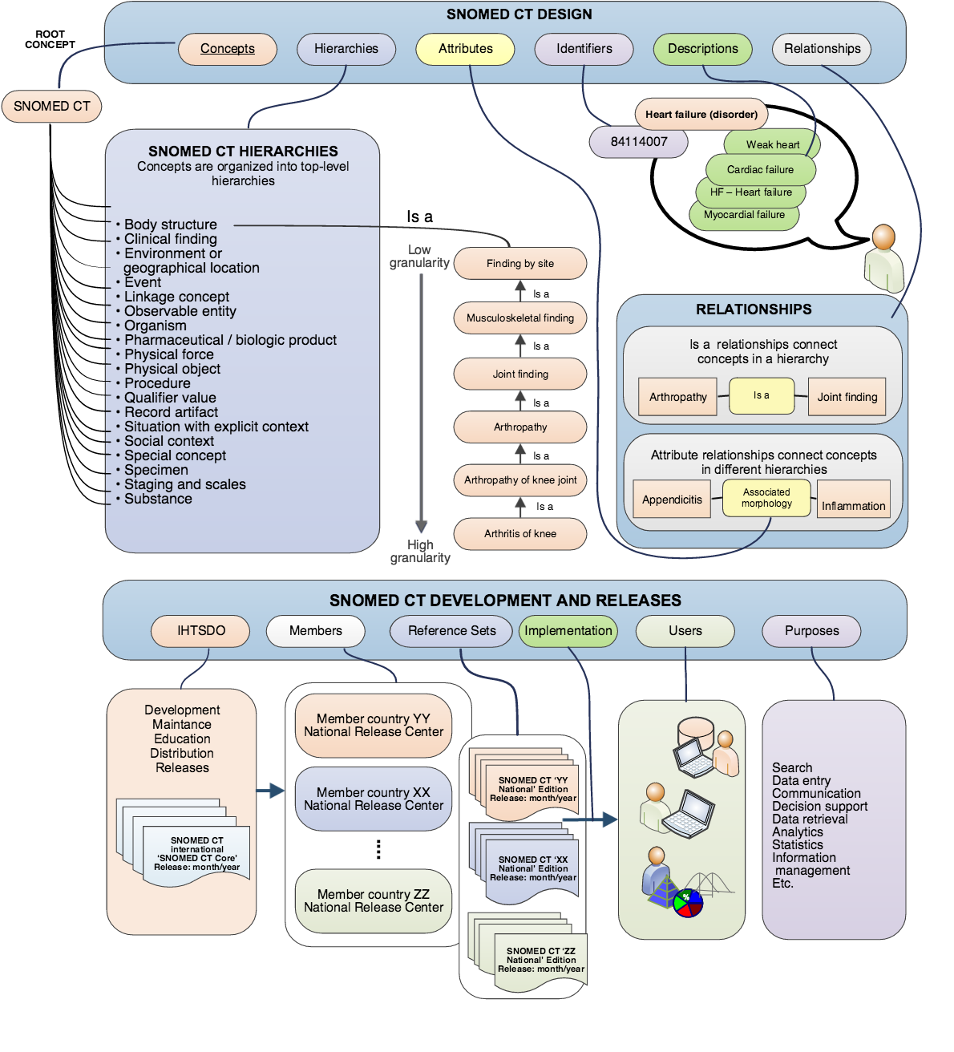

Slide 16
Concepts are “ideas” or “thoughts” of physicians
Concepts: the building block of SNOMED
Blood pressure
Lung
von Recklinghausen's bone disease
Sitting Blood pressure
toe
inflammation
mild
finger
moderate
ischaemic
infection
severe
acute
bacterial
cough
exertional
viral
angina
phlegm
Notes:
So we’ve looked at the content that makes up SNOMED CT but what about the individual components. These are referred to as concepts. Concepts can be thought of as the clinical utterances made by clinicians as shown here. The next few slides will show what a concept is in a bit more detail.

Slide 17
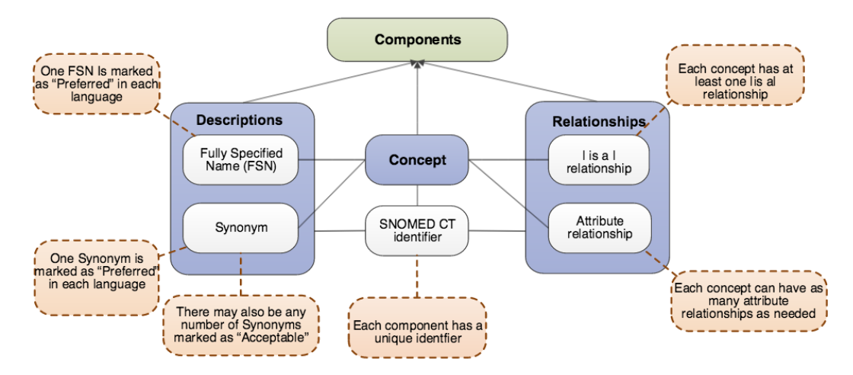
SNOMED CT Logical Model

Slide 18
A Concept
Codes and descriptions
Relationships
Is a
Qualifiers & values
Attributes
Notes:
A concept is identified by its code and descriptions but it also has relationships which establish what kind of concept it is (e.g. Clinical finding, procedure) and these relationships further define the concept to give us more information about it such as finding site (concept pneumonia has finding site of lung structure) and laterality (left or right)

Slide 19
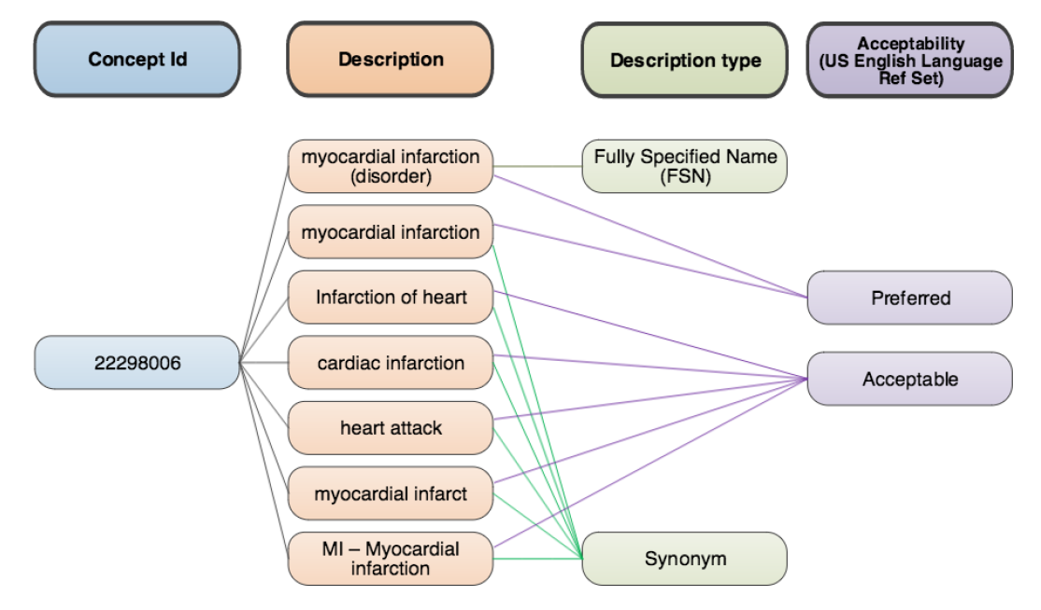
Concept
SNOMED Browser: https://browser.ihtsdotools.org/?perspective=full&conceptId1=404684003&edition=MAIN/2020-07-31&release=&languages=en

Slide 20
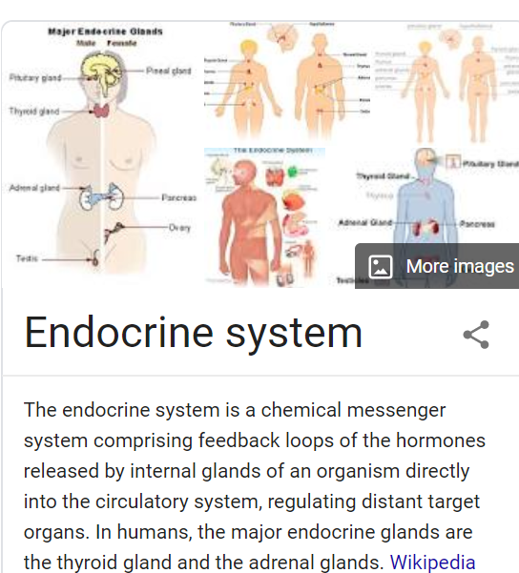
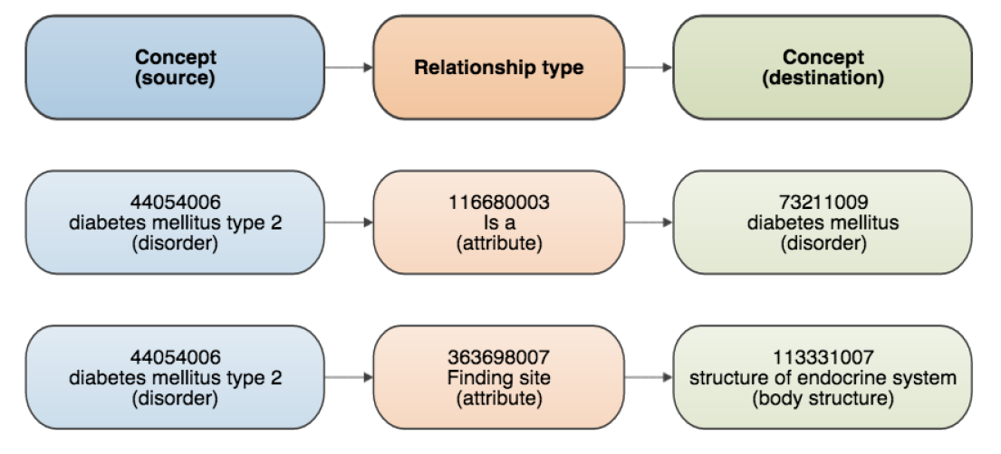
Relationship

Slide 21
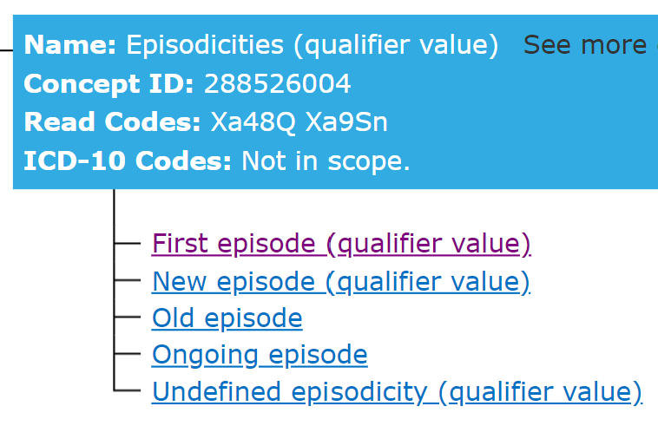
A Concept in SNOMED CT
Example: It might be possible to qualify a disorder such as 53084003 |bacterial pneumonia| according to its clinical course ( 53737009 |acute| or 90734009 |chronic|) or severity ("mild," "moderate" or 24484000 |severe|).
Preferred Term: Heart Disease
Synonym: Cardiopathy
Synonym: Disorder of Heart
Synonym: Morbus Cordis
Synonym: Cardiac Disorder
Synonym: Cardiac Diseases
Synonym: Heart Diseases
Heart disease (disorder) 56265001
Relationships
Is a cardiac finding
Is a disorder of mediastinum
Is a disorder of cardiovascular system
Finding site heart structure
Severity
Episodicity
Courses
Notes:
In this example we are looking at heart disease.
We can see the unique human readable form and the unique ID for the concept, but we can also see the Preferred Term, the one that most clinicians use for this disorder together with a list of Synonyms which are different ways of saying the same thing.
We can also see that we are provided with more information about this disorder, we know that it is “a cardiac finding” and “a disorder of cardiovascular system”.
As well as that we can see that it occurs in the heart structure. This can be very useful if you wanted to find all disorders that occur in the heart structure as you could search for disorders with a finding site of heart structure and you wouldn’t need to remember all the disorders.

Slide 22
Disease
Infectious disease
Disorder by body site
Disorder of trunk
Infection by site
Bacterial infectious disease
Disorder of thorax
Respiratory tract infection
Bacterial infection by site
Disorder of lung
Lower respiratory tract infection
Lung consolidation
Bacterial respiratory infection
Pneumonia
Infectious disease of lung
Infective pneumonia
Bacterial lower respiratory infection
Bacterial pneumonia
Notes:
In SNOMED CT concepts can be linked to more than one concept, however, they will always be in the same hierarchy, e.g. procedures. The view you can see here is actually a simplified view to show you how concepts relate to each other.

Slide 23
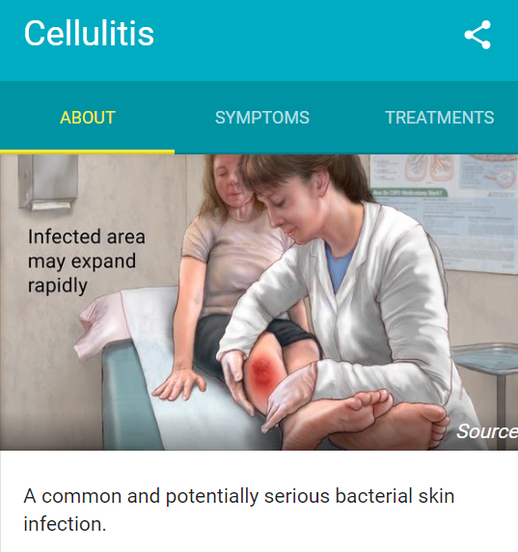
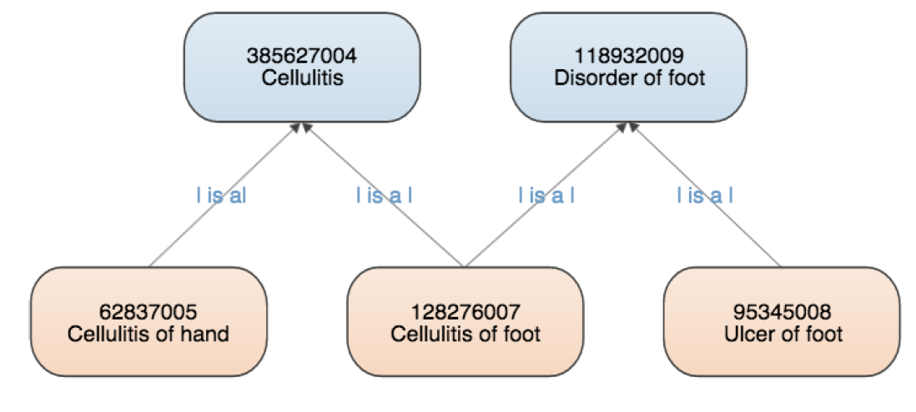
Is-a relationship

Slide 24
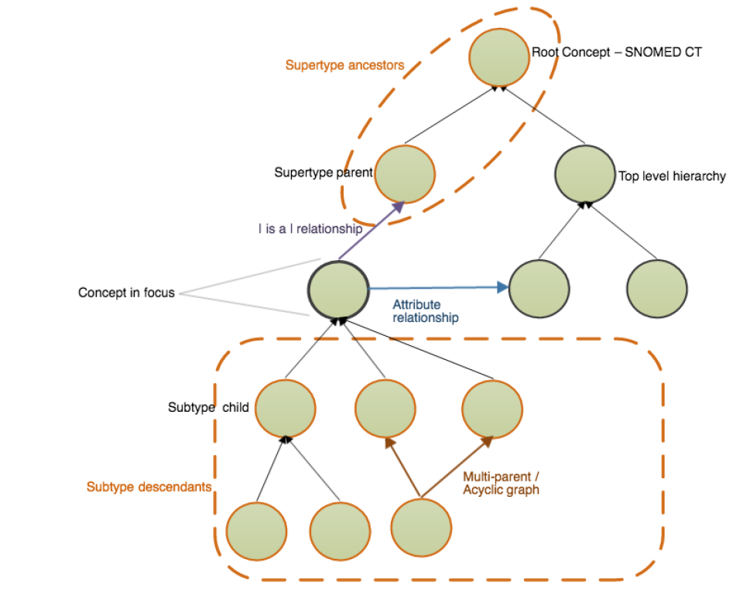
Subtype hierarchy

Slide 25
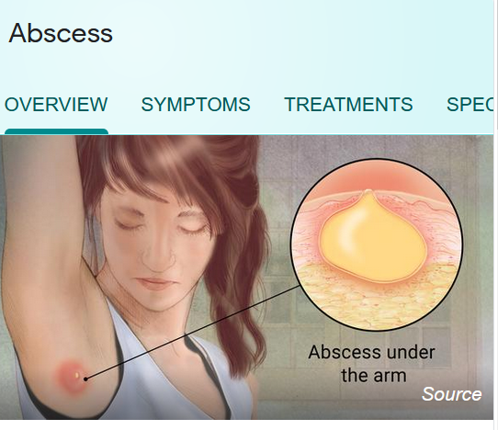
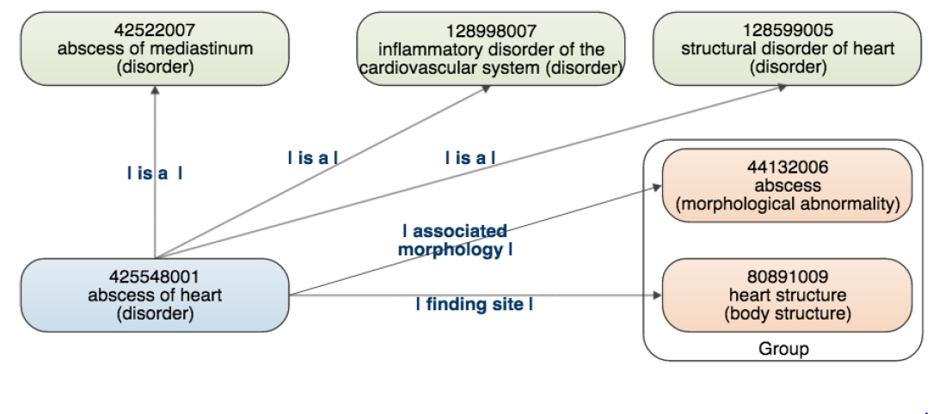
Attribute relationship

Slide 26
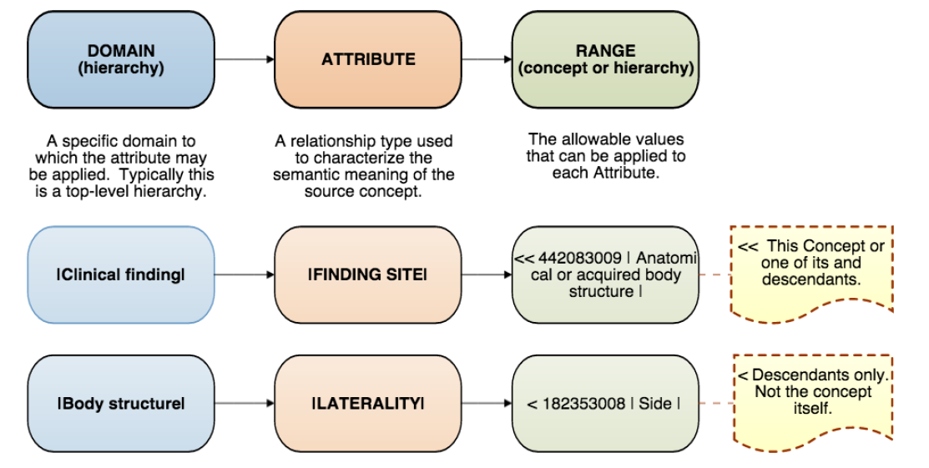
Domain and Range

Slide 27
SNOMED Browser
https://browser.ihtsdotools.org/
Use singular: leg, not legs
No need to use fully spell-out words: diab would return both diabetic and diabetes
Avoid words like: and, or, the
Notes:
Go to browser and look at
Heart disease – point out what we’ve just seen
Fundus – go through how you work out which one is which
Blood glucose level – point out the difference between the procedure and the finding
Diabetes mellitus – use this to show how the hierarchies show all the different types of diabetes mellitus
Some fun ones:
Spangled drongo – use this to show how you can go up the hierarchies to work out what something is. It’s a black shiny Australian bird.
Spacecraft – included because its an international product and the Americans have the space shuttle

Slide 28
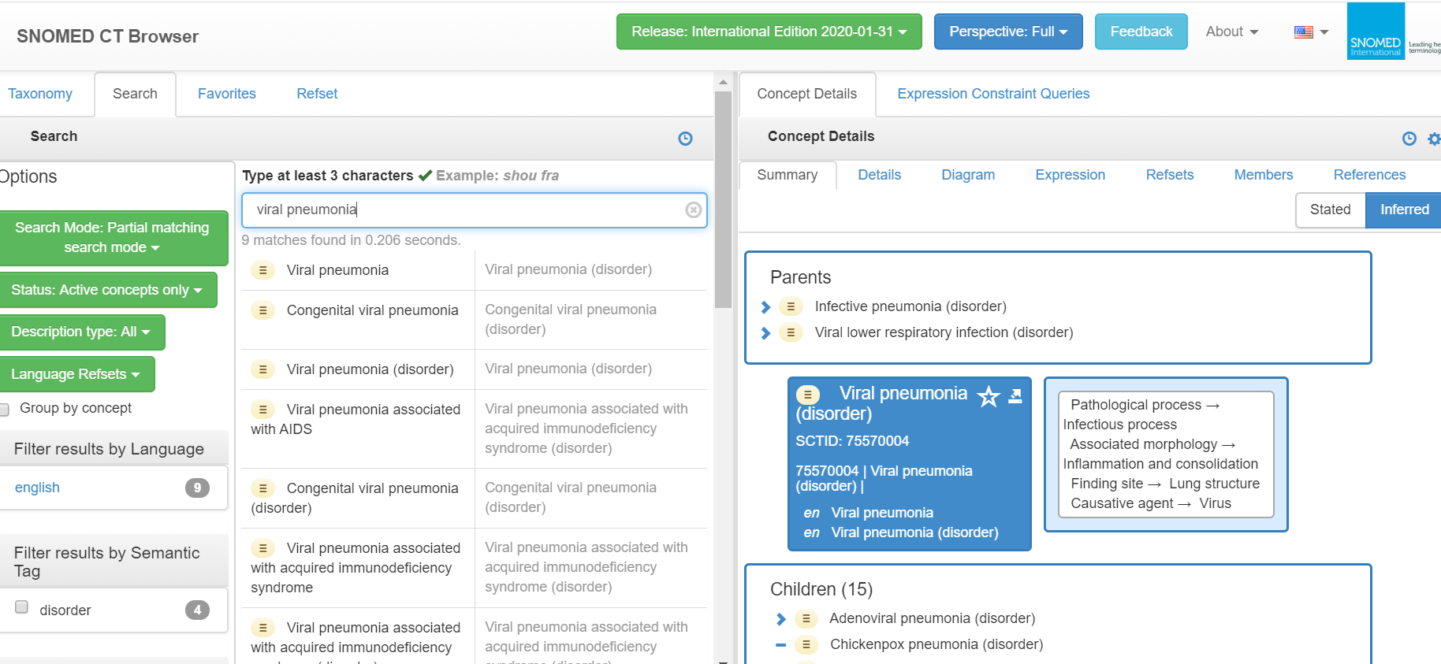

Slide 29
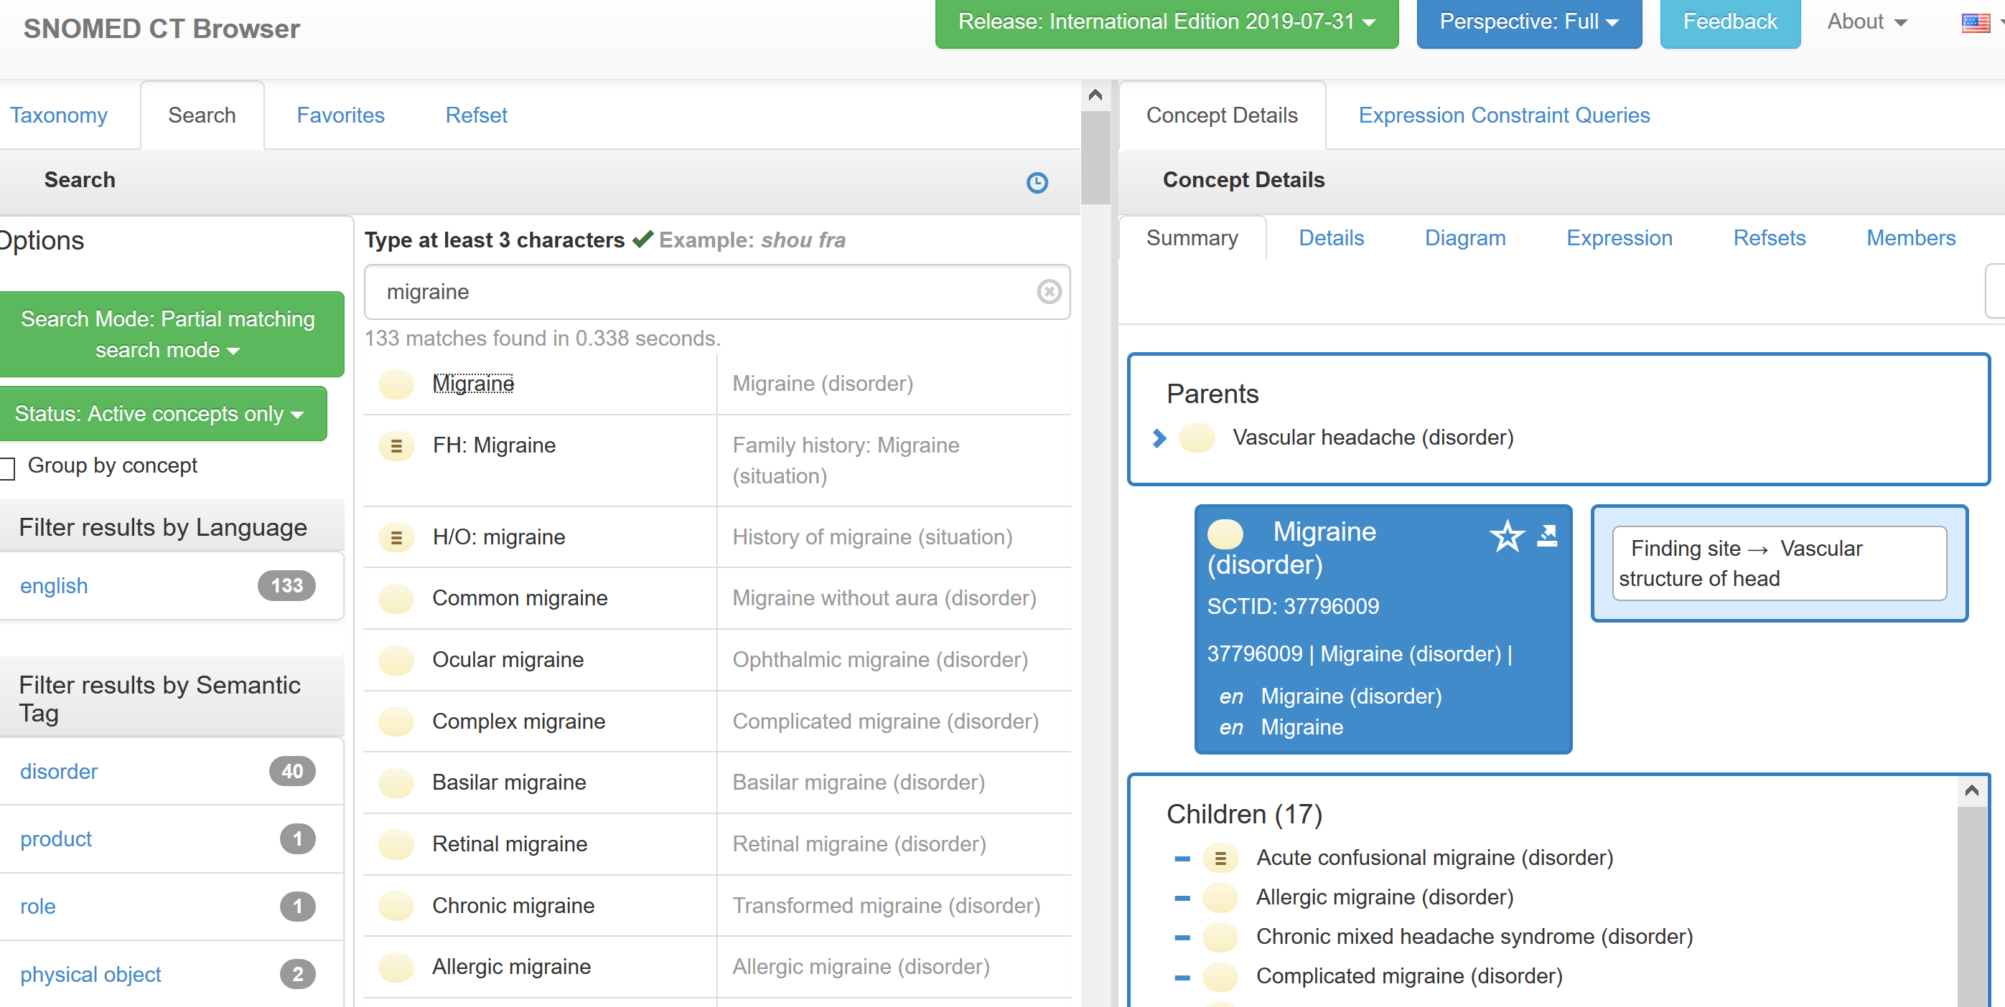

Slide 30
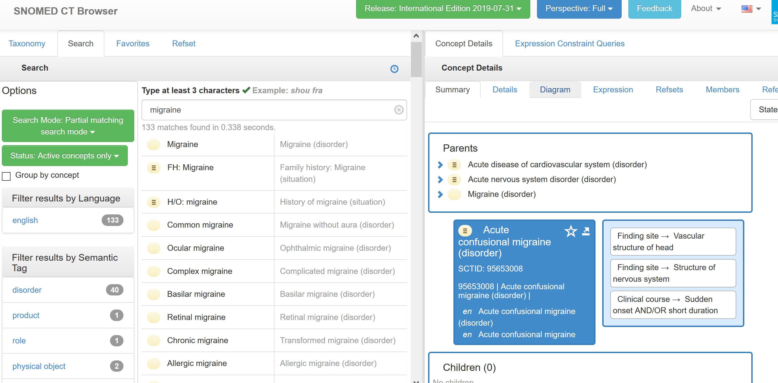

Slide 31
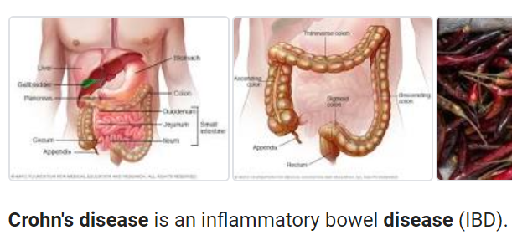
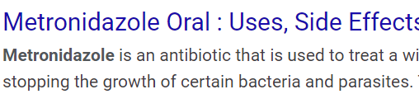
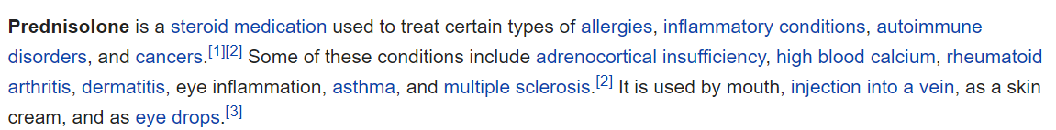
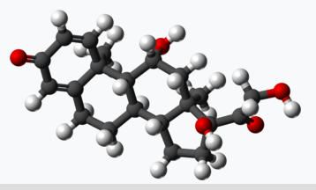
Example: EMR using SNOMED CT
Diagnoses – e.g. Crohn’s Disease
Procedures – e.g. colonoscopy with biopsy
Allergies – e.g. metronidazole
Symptoms – e.g. abdominal pain
Drugs – e.g. prednisolone

Slide 32
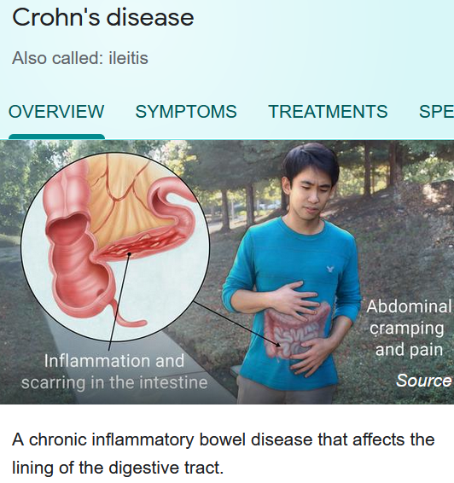


What the Clinician Sees
Crohn’s Disease
34000006
Notes:
Clinicians will see terms and will search on terms they are familiar with.
They will not see codes and are not expected to remember codes.

Slide 33
Why use SNOMED CT
If it is decided to admit a patient in Emergency, a structured form is completed with details of the speciality referred to and treatment required. When these are recorded in SNOMED CT they can be sent electronically to the GP so they are kept informed of key information about their patients.
The recording of Allergies and Adverse Reactions can be critical for the effective care of a patient. Ensuring these are clearly recorded for use by other clinicians is an ideal use of SNOMED CT.
Once the intervention has been completed a discharge summary is returned to the GP and may contain SNOMED CT terms that could be taken straight into the GP system

Slide 34

Benefit: Across Professions
Synonyms – same concept said in different ways to support cross discipline working
Patient – black eye
Doctor – contusion of eye
Nurse – bruise of eye
Notes:
Synonyms will support the way different professions refer to the same clinical term

Slide 35
Benefit: Across Professions
Across primary, secondary, community, social care, mental health
Patient Data
Primary Care
Secondary Care
Community
Mental Health
Notes:
Information can be shared across primary, secondary and other care sectors such as prisons and Ministry of Defence.

Slide 36
Benefit: Communication – “Connect all”
Seamless transfer - coded information to be electronically communicated - without mapping
SNOMED CT Data
Primary Care
Secondary Care
Community
Mental Health
Notes:
With SNOMED CT as the standard, the transfer of information can be done easily without the need to map between different terminologies.

Slide 37


Benefit: Communication – “Connect all”
Translated into different languages: Spanish, French, Swedish, Danish ... Work starting in Lithuanian, Polish
morphine allergy
morfin allergi
Notes:
SNOMED CT has already been translated into different languages meaning that in the future there is the possibility of transferring information internationally

Slide 38
More Benefits
Across different specialisms: orthopaedics, cardiology, renal, microbiology, histopathology ...
Across primary, secondary, community, social care, mental health
Synonyms – same concept said in different ways to support cross discipline working
Seamless transfer - coded information to be electronically communicated - without mapping
Translated into different languages: Spanish, French, Swedish, Danish ... Work starting in Lithuanian, Polish

Slide 39
More Benefits
Suppliers in different countries using the same terminology
Potential for improved functionality of systems as supporting just one terminology
Collaborative effort: more cost effective
Links with other international standards – eg. World Health Organisation

Slide 40
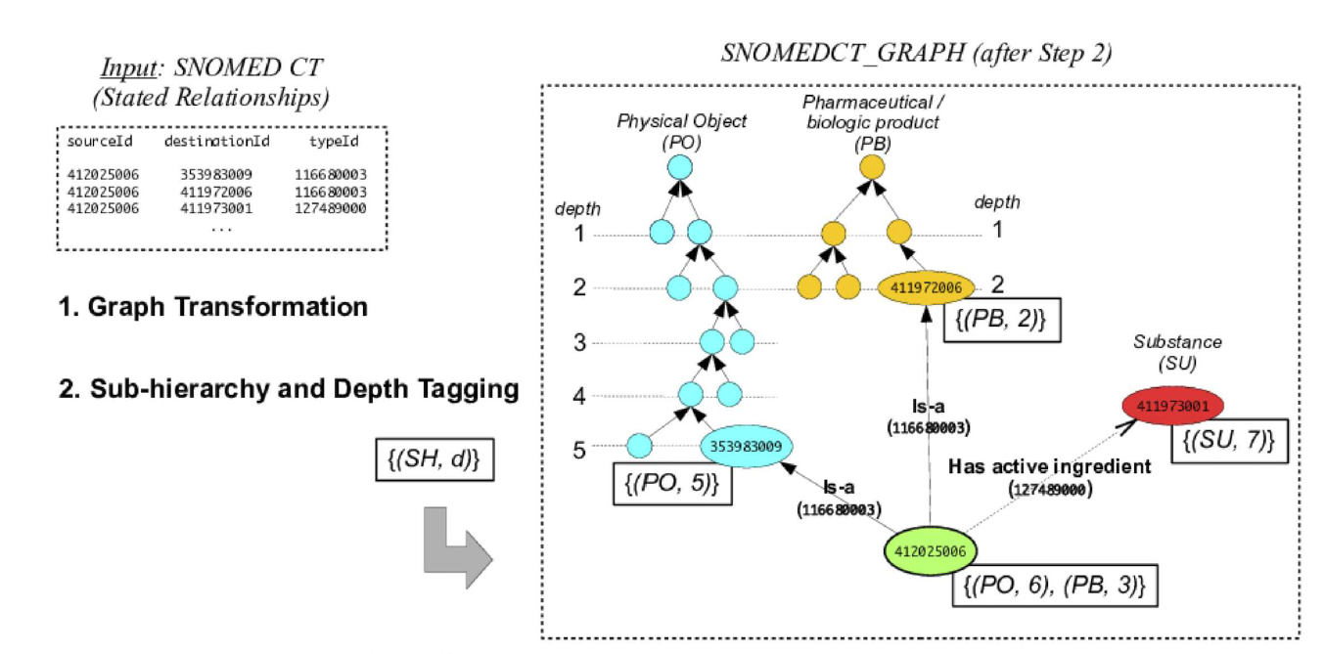
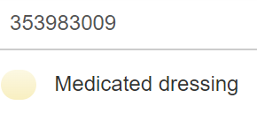
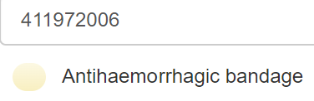
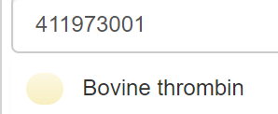
SNOMED Graph
Thrombin embedded bandage (ID 412025006) is tagged with both (PO,
6) and (PB, 3))

Slide 41
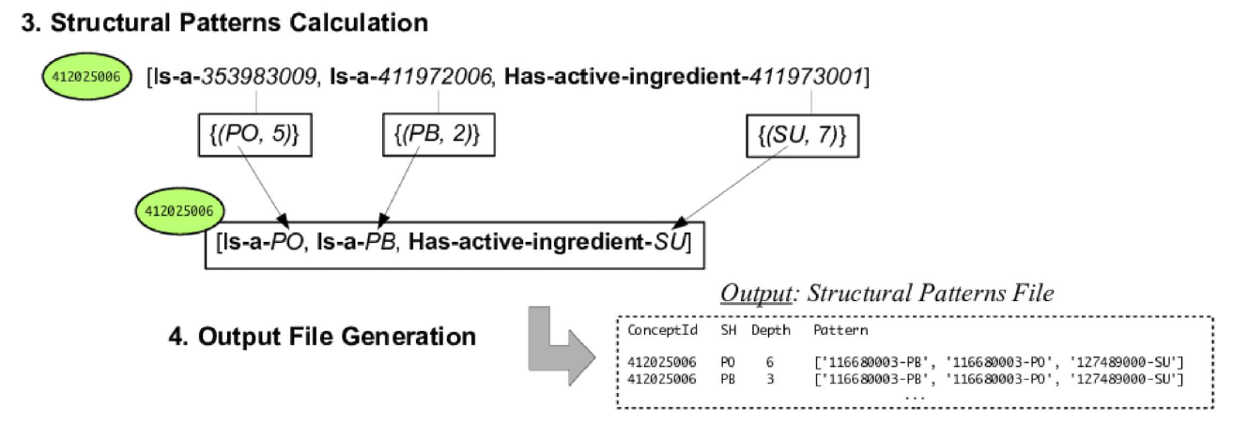

Slide 42
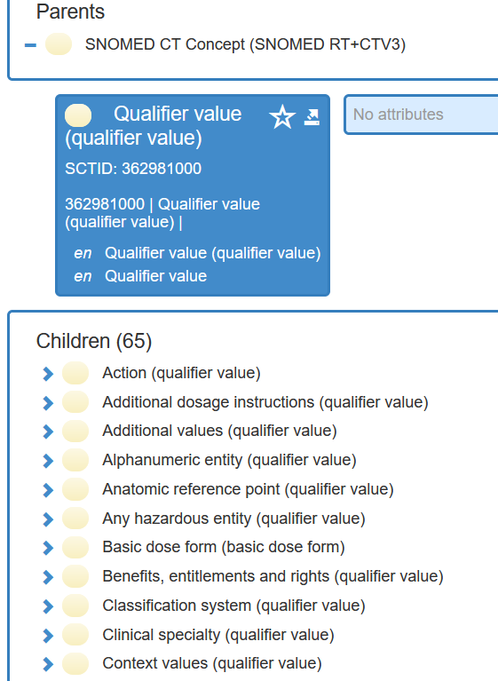
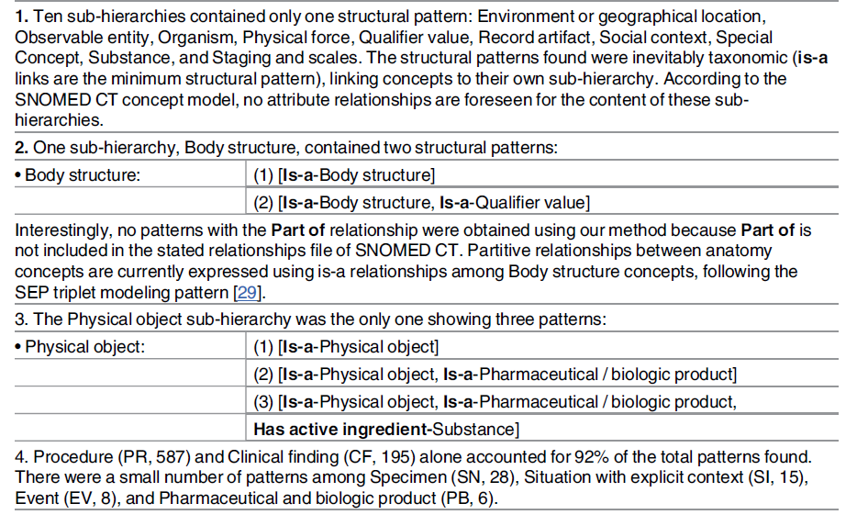
Sub-hierarchies of SNOMED

Slide 43
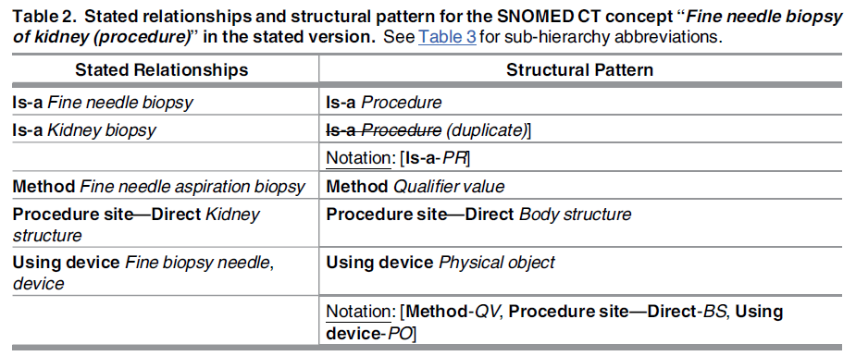
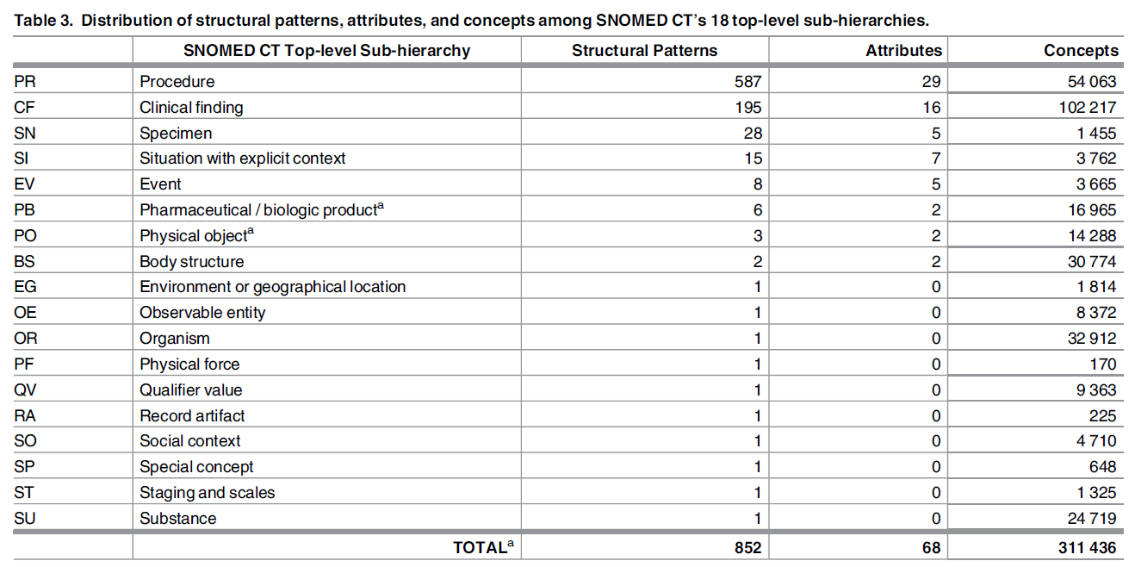
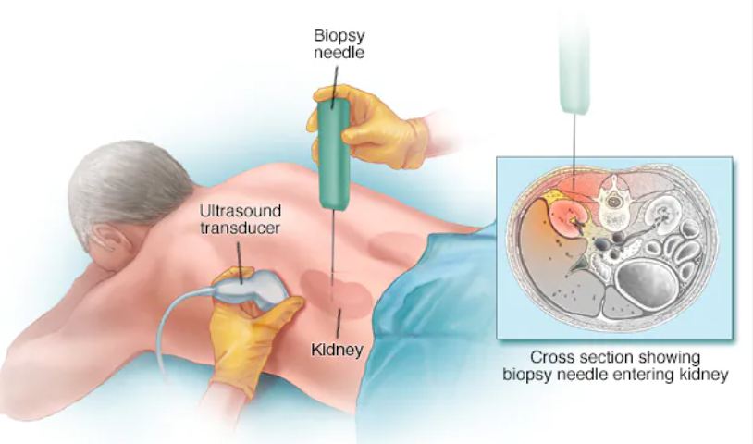
SNOMED Hierarchies

Slide 44
SNOMED issues
Quality issues
51% of SNOMED CT concepts did not exhibit any descriptive difference between parent and child.
12% of SNOMED CT concepts contained redundant axioms in their descriptions, i.e., clauses that are stated in the formal description of a given concept but which can also be inferred from a parent.
18 000 SNOMED CT concepts for which the wording suggested a connection to other concepts, but such connections were missing.

Slide 45
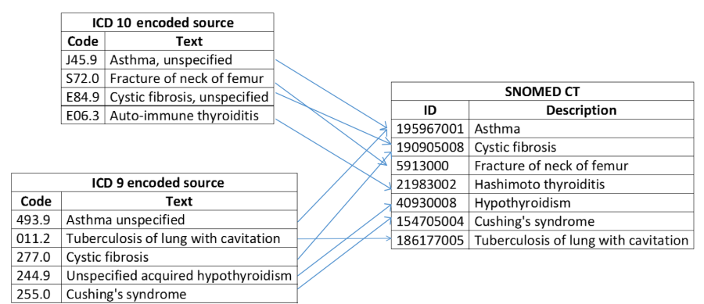
Mapping between SNOMED and ICD

Slide 46
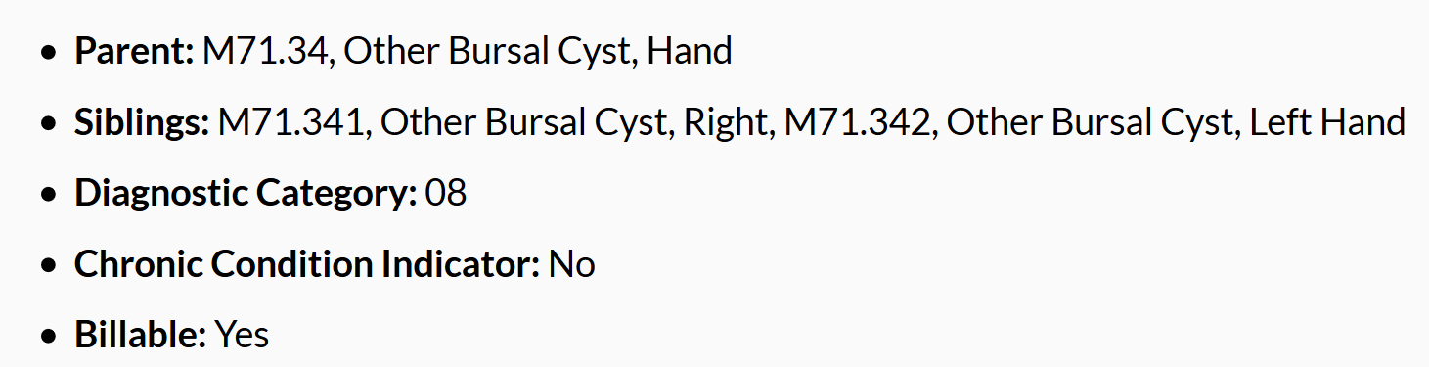
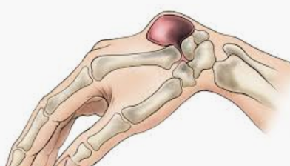
ICD 10
https://icd.who.int/browse10/2019/en (WHO)
https://icd10cmtool.cdc.gov/ (CDC)

Slide 47
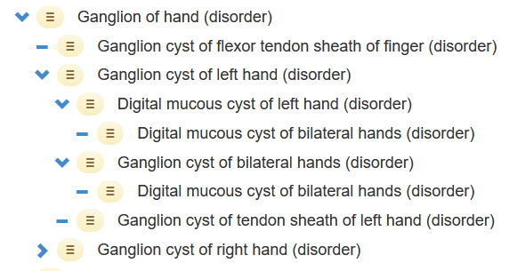
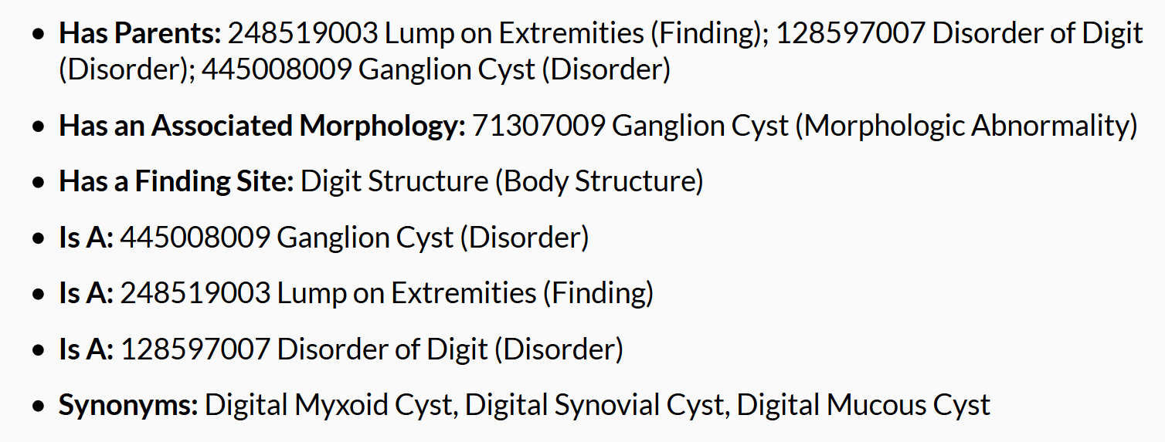
SNOMED CT

Slide 48
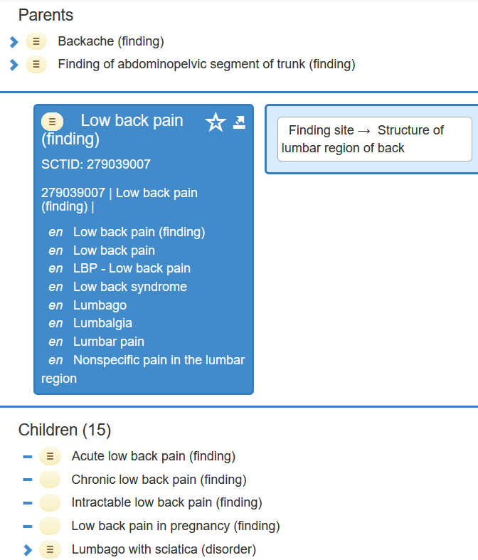
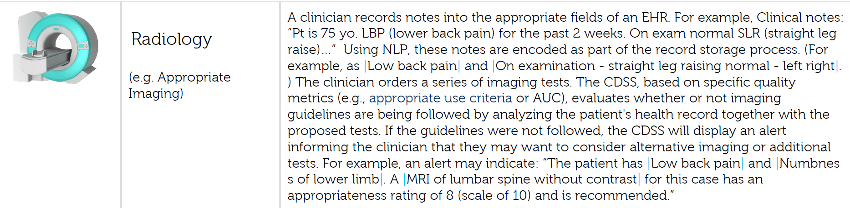
SNOMED in Diagnosis

Slide 49
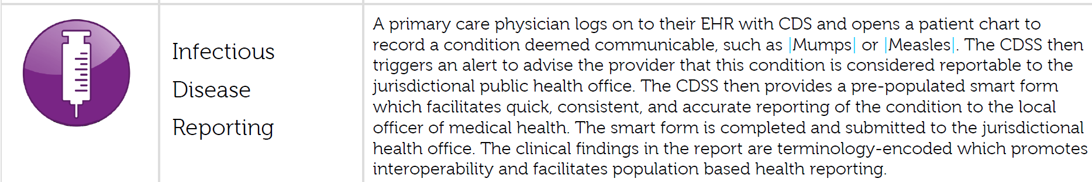
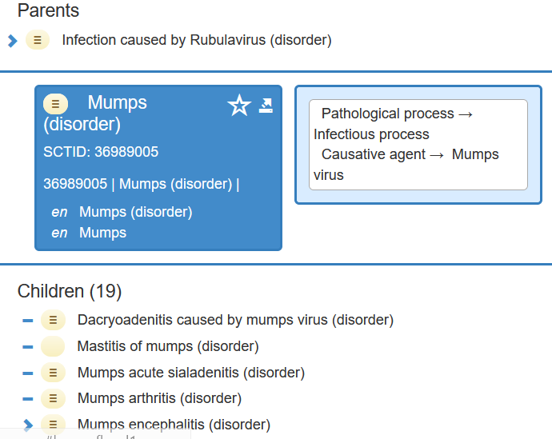

Slide 50
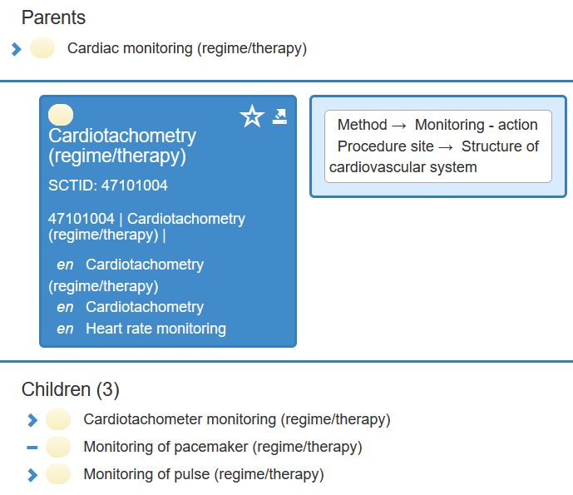
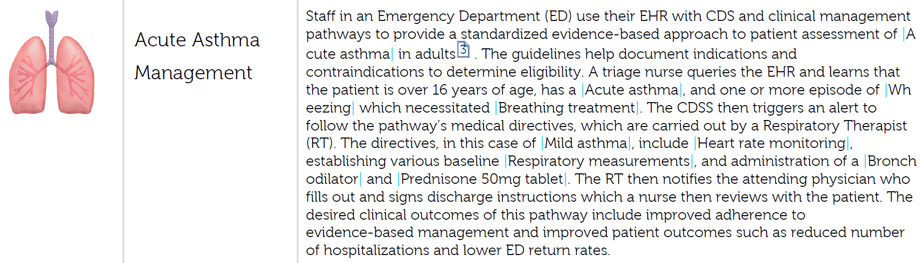
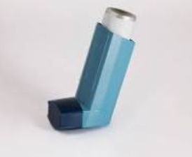

Slide 51
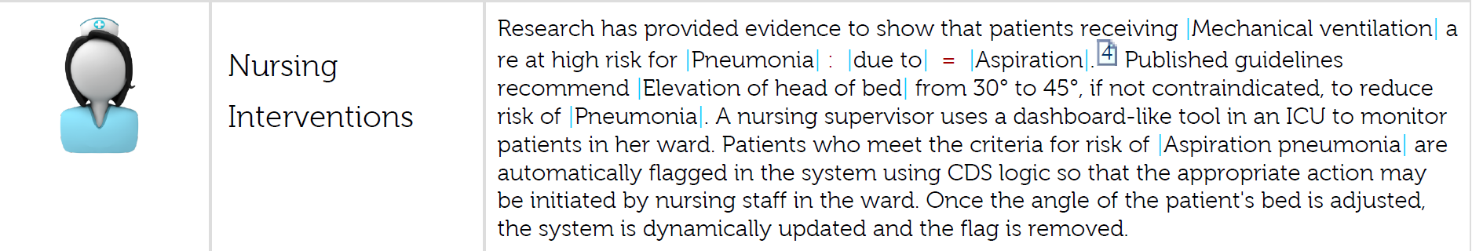
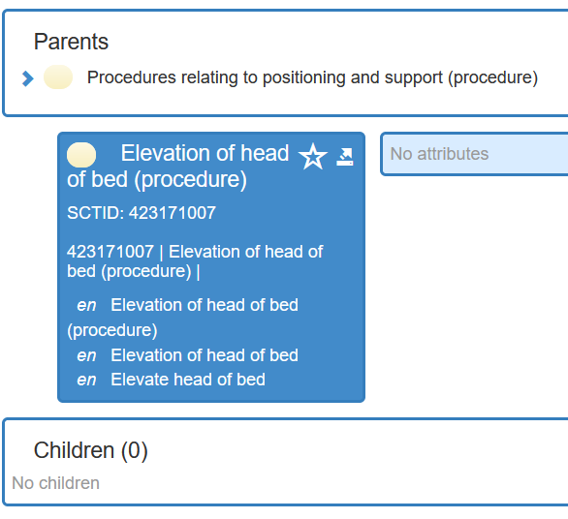
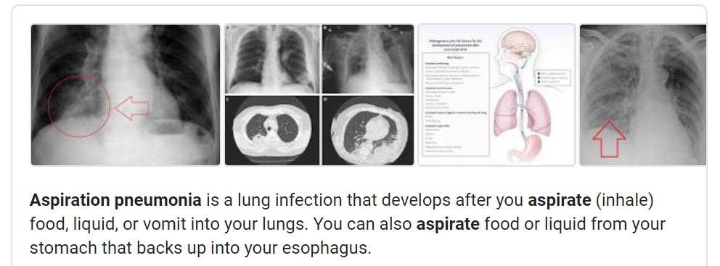

Slide 52
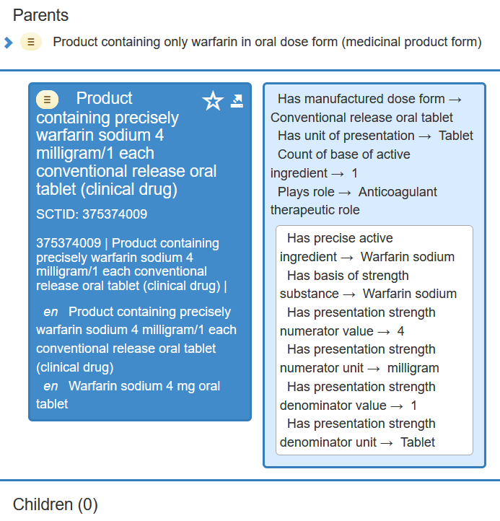


Slide 53



Slide 54




Slide 55



Slide 56

Clinical Note 2
23 F with h/o Lupus, ESRD not on HD (planned PD), labile hypertension, RUE VTE on anticoagulation, recent facial swelling who presents with hypertensive emergency. Patient developed severe frontal HA last evening, a/w nausea. BP was not [**Location (un) 1131**] on home BP cuff. In the AM her HA was severe [**10-20**] a/w nausea and vomiting yellow/green liquid and BP cuff again not able to obtain BP. Patient was last seen by VNA this past Friday with BP 130/70. Patient denies any CP, shortness of breath, abd pain. Her facial swelling is slightly worse today. She denies any weakness, dizziness, difficulty with speech, no numbness or tingling. She says that she is compliant with all of her medications. She denies any GU/GI complaints despite +UA in ED.

Slide 57

Data analysis using SNOMED
NLP extraction

Slide 58

NLP extraction with context

Slide 59
Clinical Note 3
62yo RH M h/o HTN, Afib on coumadin, CAD s/p PTCA x 2 in [**2178**] who was in USOH today when he began to have a mild right-sided headache around noon, a/w some photophobia and nausea. He was sitting at the computer half an hour later when he got up to go to [**Company 7546**] and noticed that his L foot was numb and "wobbly". The foot felt weak, "like it was asleep". He walked but was tripping and went to get a banana, thinking that he needed to eat something. He took his pulse which was regular and went to drive to [**Company 7546**]. While driving though, he felt confused and turned around. When he got home, he called his daughter and asked her if his speech was slurred, thinking he may be having a stroke. It was not and he had no difficulty speaking or comprehending what she was saying. She called 911 to get him checked out and he was brought to an OSH. There, the family noticed an increasing left facial droop. His ankle felt better. Head CT showed an ICH and INR was 2.89 and the patient was given 3U FFP, vit K 5mg IM, labetalol 10mg IV x 1 and dilantin 1g IV was started but d/c'd due to hypotension. The patient was then transferred here.

Slide 60


Using ChatGPT to identify SNOMED CT Terms

Slide 61

SNOMED in Clinical Decision Support System (CDSS)

Slide 62


Slide 63


Slide 64


Slide 65


Slide 66



Slide 67

Clinical Decision Rules

Slide 68


Slide 69


Slide 70



Population Health

Slide 71

Population Health

Slide 72
References
SNOMED Browser
https://browser.ihtsdotools.org/?
SNOMED Starter Guide
https://confluence.ihtsdotools.org/display/DOCSTART/SNOMED+CT+Starter+Guide
SNOMED Documents
https://confluence.ihtsdotools.org/display/DOC/SNOMED+CT+Document+Library
https://www.snomed.org/snomed-ct/snomed-in-action
https://www.snomed.org

